Slide 1
Installing and maintain hardware

Slide 2
Thing to do before you can changing hardware
When changing any hardware in any system you need to make sure to backup your files of important data so you don’t loose them.
Check to see if the stored data can be easily moved to the other machine for compatibility
Run antivirus – before you start you need to make sure no broken files or virus can harm the software files which may prevent booting up after you reinstall the backup.
Defragment . This organise the files so that you have more room to install RAM to have a bigger capacity.

Slide 3

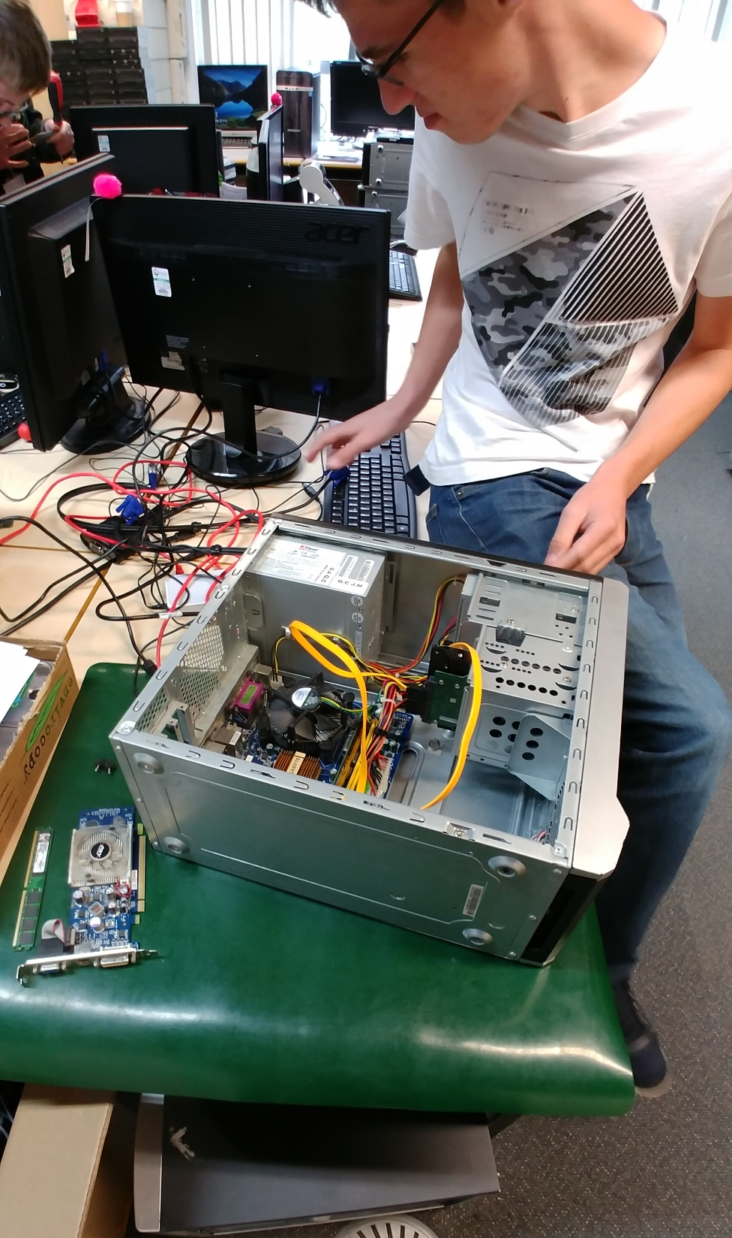
What did I do
After looking at the computer system and finding that the machine didn’t boot up I knew it was something to do with the power to the motherboard so after checking the power cable and the VGA cable to the monitor I found that the cable wasn’t plugged in. which was simple as I had to plug in the cables to the motherboard

Slide 4
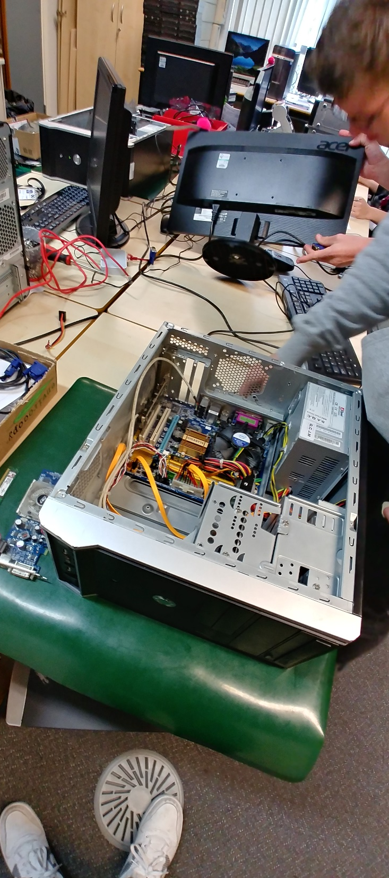
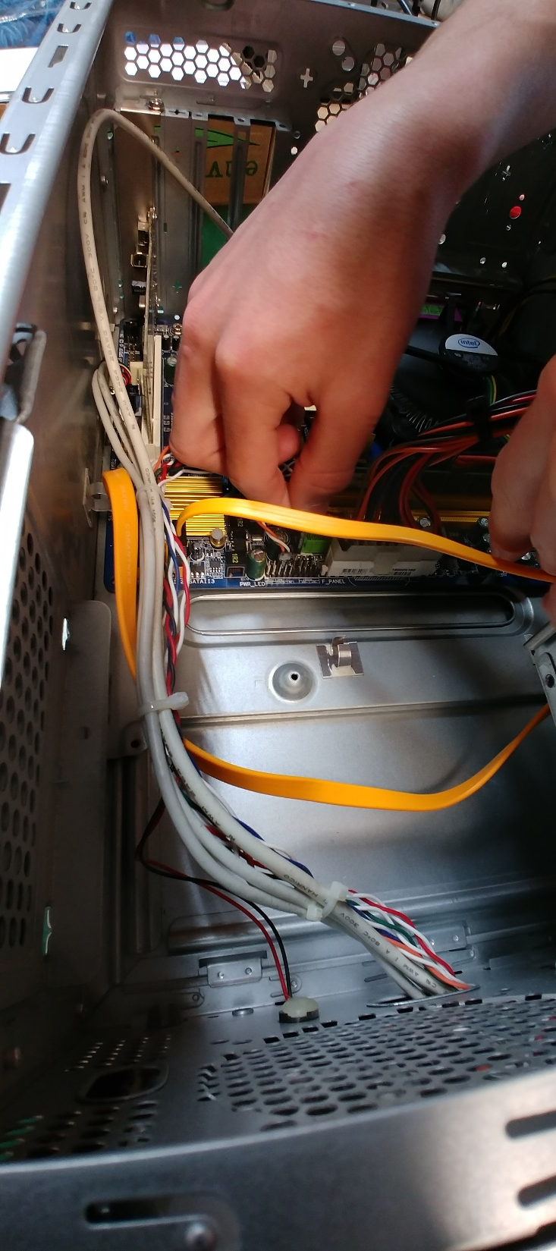
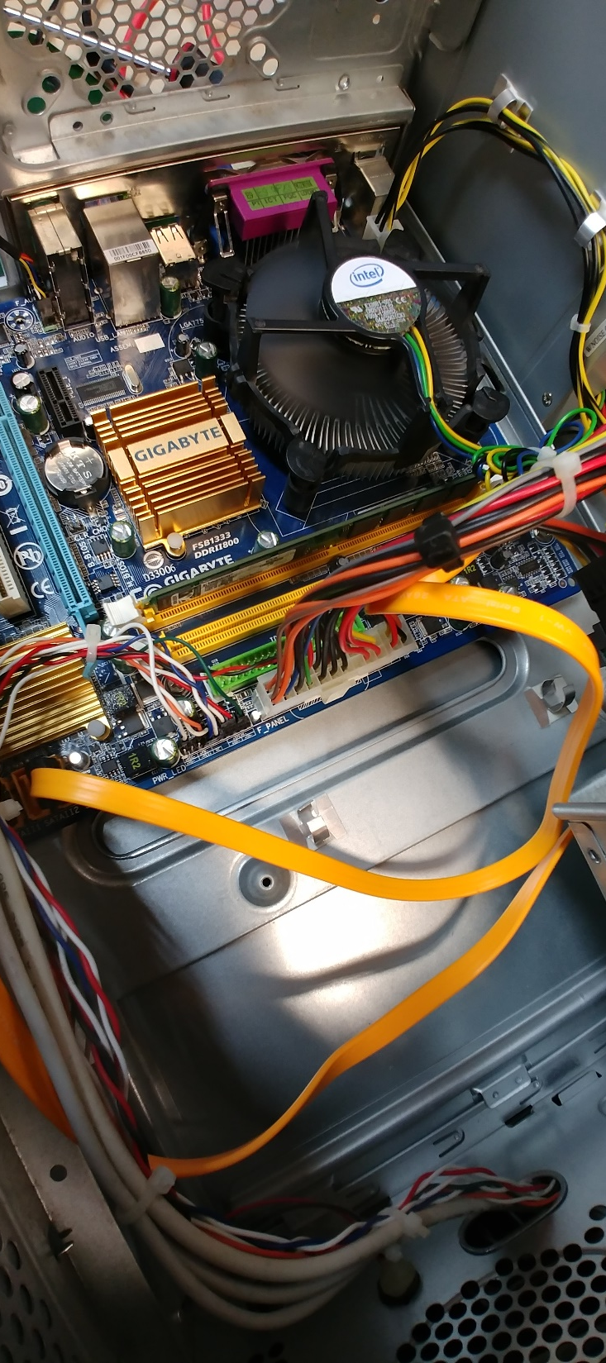
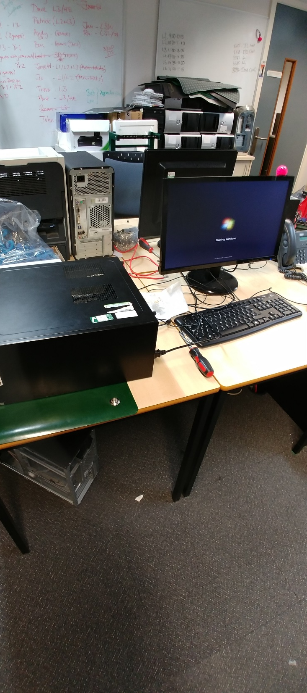
Pictures
Here Is some evidence of my work and me testing out.

Slide 5


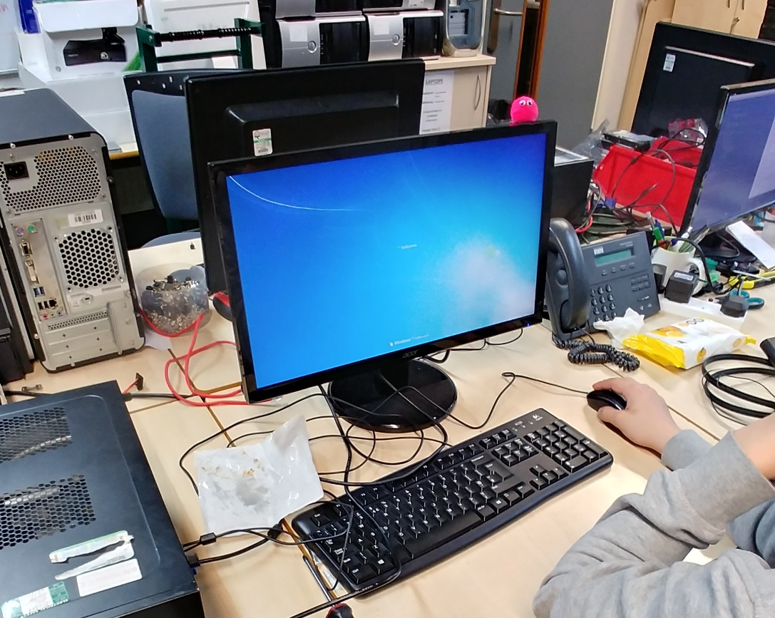



The Final Result!
Here is the finished result and it loading up for the first time.
there was no problem starting the machine as I loaded into windows correctly

Slide 6
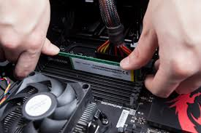
Installing the hardware
Here are some images of me installing ram. It is so simple as I just clicks in to the motherboard
I also inserted a new graphics card.
Without any ram a computer will be harder to run off the cpu and slow down the performance

Slide 7
Testing the equipment
Did the modified technology system meet user requirements?
The modified machine booted up and was able to run with the graphics card.
Did the machine run more smoothly?
the machine was smooth and the was able to show its full potential.
Did the restore work?
all information was able to get back on to the machine and was able to access the files saved previously.

Slide 8
Client Feedback
After meeting with the client and presenting to them of my work we agreed that the machine was running to its maximum capacity. All of the hardware help to make the machine more efficient and help cut costs on electricity and other bills.
We decided that the computer was to its best of the time and if need be in the future we can upgrade if new hardware is released.
“The system met my need and no further reaction is required” – client

